Slide 1


8th International Conference for Convergence in Technology (8th I2CT 2023)
Monkeypox Detection from Various Types of Poxes:
A Deep Learning Approach
Paper ID: 2301
Fayazunnesa Chowdhury
Daffodil International University, Dhaka, Bangladesh

Slide 2
Contents
Introduction
Objectives
Literature Review
Methodology
Model Analysis & Results
Discussions
Conclusion
References

Slide 3
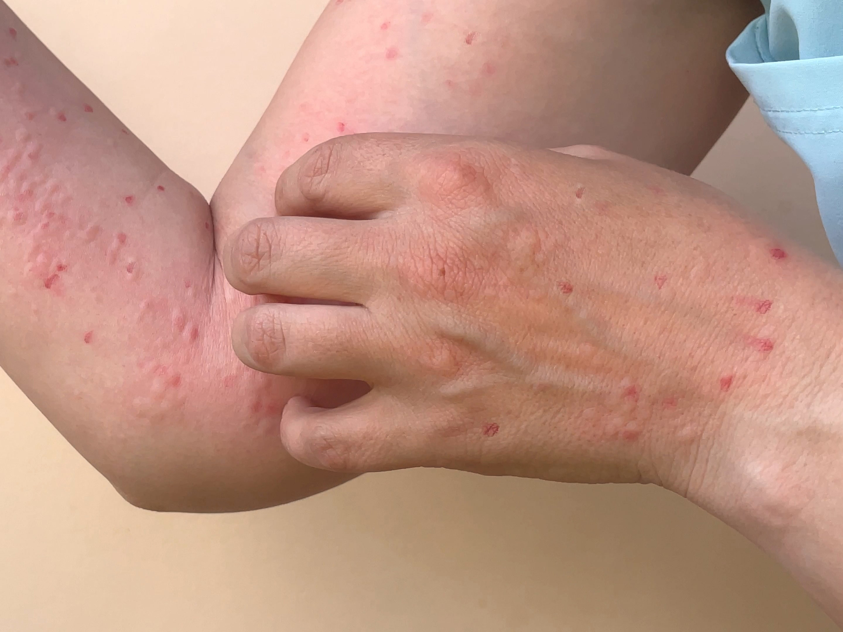
Introduction
Monkeypox can transfer to people by adjacent association with animals or person who has the disease, or by coming into contact with objects infected with the virus.
According to World Health Organization (WHO) statistics, a monkeypox outbreak has been detected in 127 countries so far and is rapidly expanding throughout the world.
While the skin lesions and rashes of monkeypox frequently resemble those of other poxes, such as chickenpox and measles.
Healthcare workers also lack expertise because monkeypox was infrequent earlier in the current outbreak.
Therefore, Artificial Intelligence in Monkeypox detection from digital skin images can play a vital role to initiate the diagnosis processes.
Figure: Monkeypox Diease
[Source: CNN health]

Slide 4
Objectives
To detect monkeypox using image processing techniques.
To detect monkeypox more accurately and efficiently by applying transfer learning methods.
To identify monkeypox in the body part and provide a expert system based solution to this problem.
To recognize monkeypox and initiative the diagnosis immediately.
To alert the patient for taking treatment.
To help patient and doctors with a Computer Vision-based solution.

Slide 5
Literature Review
Ahsan et al. [18] used a modified version of VGG16 to look for monkeypox disease in two separate studies. The first method involved categorizing images into two disease classes: monkeypox and chickenpox, whereas the second method involved augmenting the images. Findings suggest that their proposed model can recognize Monkeypox patients with an accuracy of 97% for method one and 78% for two method.
Sitaula and Shahi [16] compared 13 distinct pre-trained deep learning (DL) models for detecting the Monkeypox virus. They used several metrics over five folds, with each fold having a 70/30 train/test ratio, to determine each DL model's performance levels. Xception and DenseNet-169 were found to be the best-performing models. Then They ensembled them by using a majority vote based on their probabilistic results. Findings suggest that the ensemble approach detects the Monkeypox virus with 87.13% accuracy and Xception DL with 86.51%.

Slide 6
Literature Review
Ali et al. [19] used VGG16, ResNet50, and InceptionV3 with the transfer learning technique to conduct a preliminary feasibility study on the "Monkeypox Skin Lesion Dataset (MSLD)" they made. They also created a model that is an ensemble of the three. A limited data set was utilized. The best overall accuracy was achieved by ResNet50 with 82.96 (± 4.57%), followed by VGG16 with 81.48 (± 6.87%) and the ensemble system with 79.26 (± 1.05%).
Using digital skin images of pox lesions and rashes, Islam et al. [21] investigated the viability of using seven deep AI models, to identify distinct kinds of pox. The ShuffleNet-V2 has the highest precision (79%). They also demonstrated the predictive ability of an ensemble of the seven deep models they developed and tuned, which outperforms other methods on every measure, especially in accuracy (83%).

Slide 7
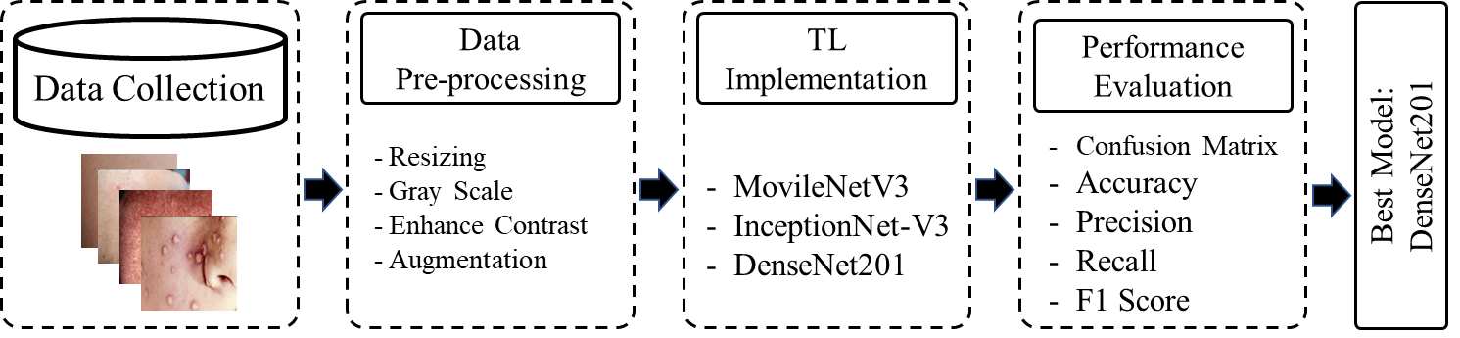
Methodology
Figure: Proposed Methodology

Slide 8
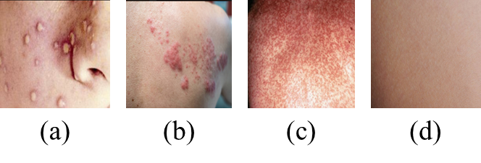
Methodology
Dataset:
Data from Kaggle
In compiling the dataset, we faced a wide range of challenges.
926 photos in our assembled and personalized monkeypox dataset.
They are divided into 770 training images and 156 testing images.
Figure: Sample image for (a) monkeypox, (b) Chickenpox, (c) Measles and (d) Fresh body.

Slide 9
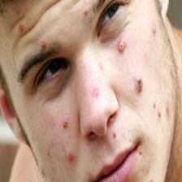
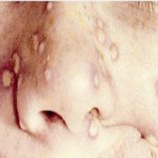
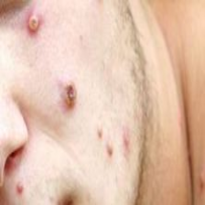
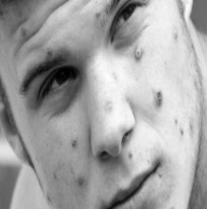
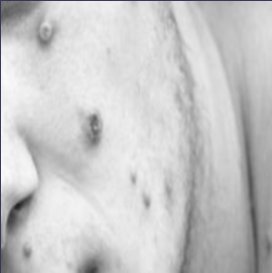
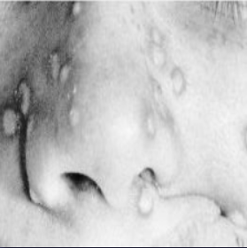
Methodology
Dataset Preprocessing
Resizing image: 224*224
Gray Scale
Enhance Contrast
Augmentation [Flip, Rotate, Zoom, …]]
Resizing Image
[Various Size of Images]
[224*224 Images]
Gray Scale Conversion
[RGB Images]
[Gray Images]

Slide 10
Methodology
Dataset Preprocessing
Resizing image: 224*224
Gray Scale
Enhance Contrast
Augmentation [Flip, Rotate, Zoom, …]]
Augmentation Techniques

Slide 11
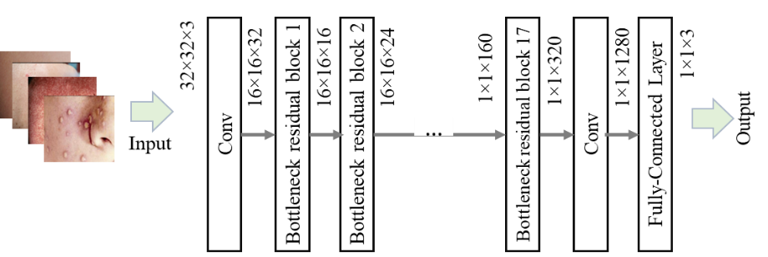
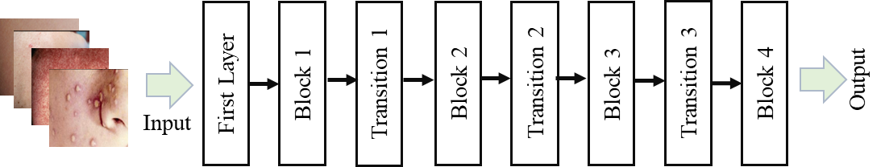
Methodology
Applied Models
MobileNet-V3
Inception-V3
DenseNet-201
MobileNet-V3
InceptionNet-V3:
DenseNet-201:

Slide 12
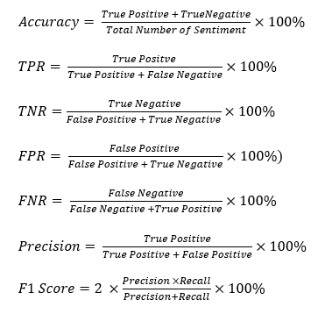
Methodology
Performance Evaluation
Confusion Matrix
Accuracy
True Positive Rate (TPR)
False Negative Rate (FNR)
False Positive Rate (FPR)
True Negative Rate (TNR)
Precision
F1 Score

Slide 13
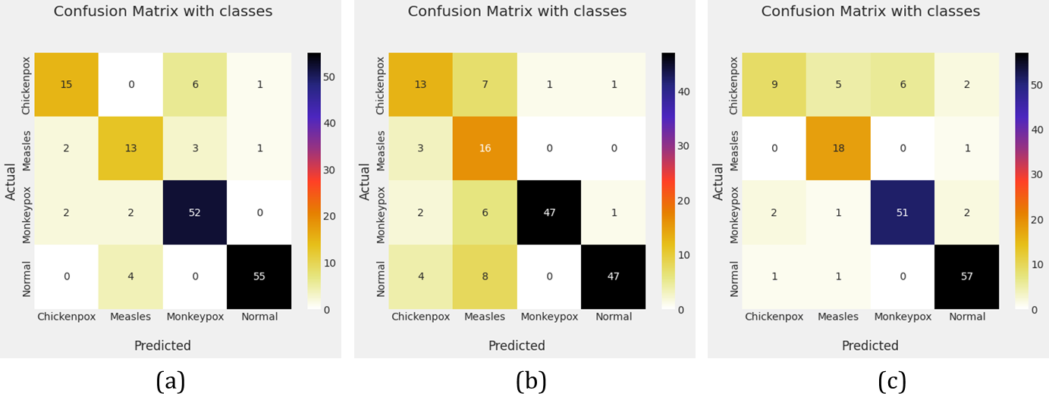
Results & Discussions
Confusion Matrix:
Maximum TP: 57 (DenseNet-201)
Maximum TN: 95 (Inception-V3)
Minimum FP: 02 (MobileNet-V2)
Minimum FN: 02 (DenseNet-201)
Figure: Confusion matrix for (a) MobileNet-V3s, (b) InceptionNet-V3 and (c) DenseNet201.

Slide 14
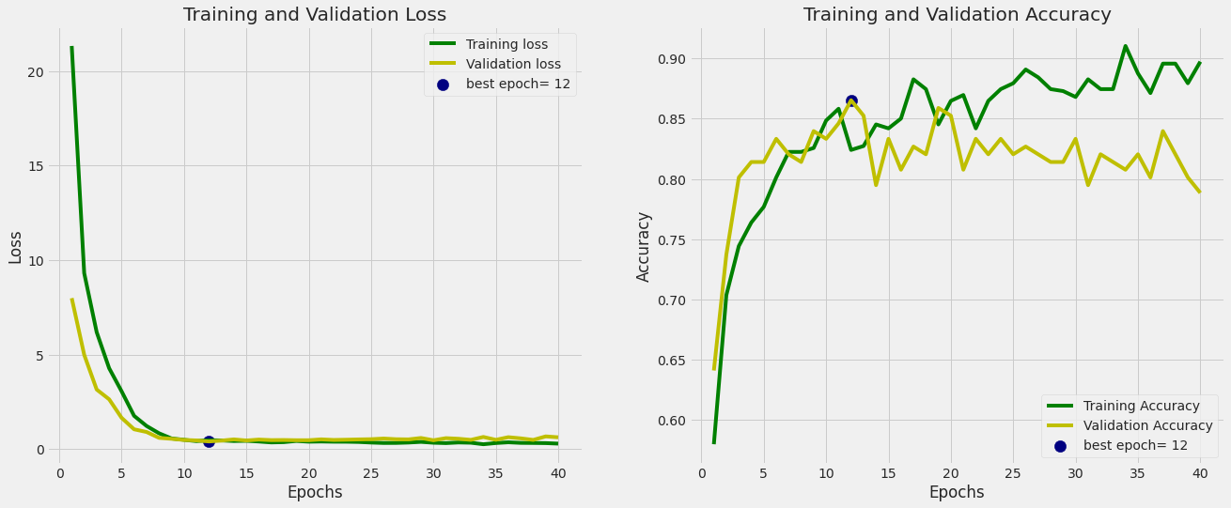
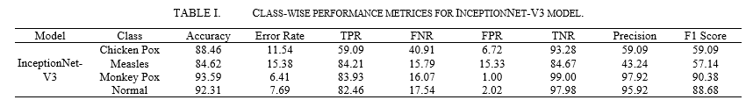
Results & Discussions
Performance for Inception-V3:
Accuracy: 93.59%
Error Rate: 6.41%
TPR: 83.93%
FNR: 16.07%
FPR: 1.00%
TNR: 99.00%
Precision: 97.92%
F1 Score: 90.38%
Figure: Validation loss and validation accuracy graph for Inception-V3 model.

Slide 15
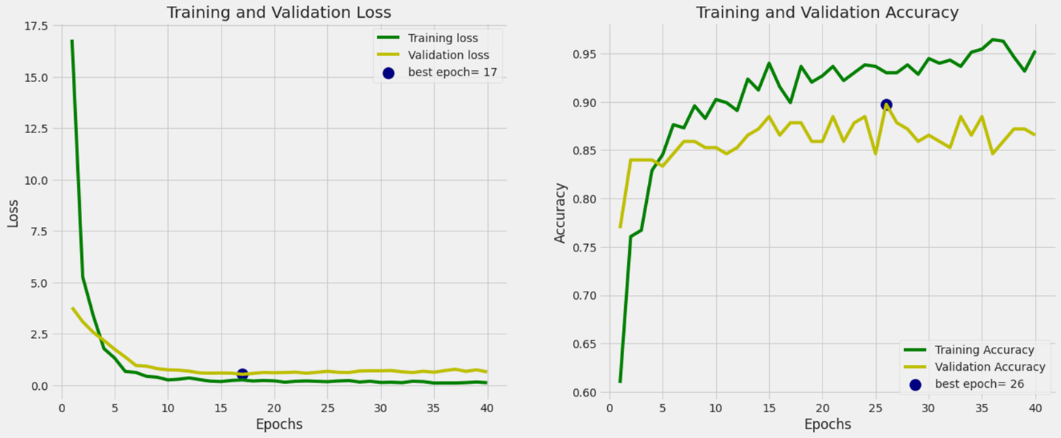
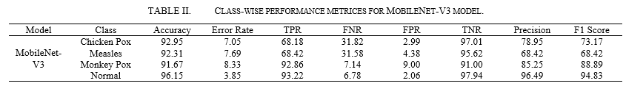
Results & Discussions
Performance for MobileNet-V3:
Accuracy: 96.15%
Error Rate: 3.85%
TPR: 93.22%
FNR: 6.78%
FPR: 2.06%
TNR: 97.94%
Precision: 96.49%
F1 Score: 94.83%
Figure: Validation loss and validation accuracy graph for MobileNet-V3 model.

Slide 16
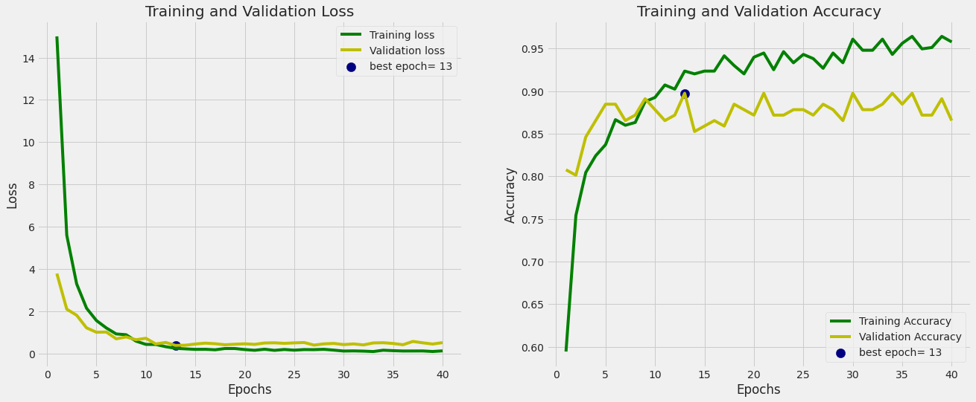
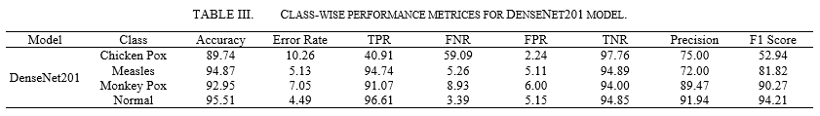
Results & Discussions
Performance for DenseNet-201:
Accuracy: 95.51%
Error Rate: 4.49%
TPR: 96.61%
FNR: 3.39%
FPR: 5.15%
TNR: 94.85%
Precision: 91.94%
F1 Score: 94.21%
Figure: Validation loss and validation accuracy graph for DenseNet-201 model.

Slide 17
Discussions
The experimental result section demonstrates that our implemented models accurately detected monkeypox with 93.59%, 91.67% and 92.95% accuracy.
This research reveals a detecting monkeypox and advises dermatologist to take appropriate steps in the future to ensure a safe treatment to avoid spreading.
Our efforts would aid in the reduction of spreading monkeypox to the world and prevent the pandemic of monkeypox.
This work’s significant advantage for medical practitioner in developing expert system and will provide us with a safe and fruitful diagnose to the patient.

Slide 18
Conclusion
In this study, we tested the efficacy of diagnosing measles and several types of pox from digital skin images of lesions and rashes using three pre-trained models.
Our tests using digital skin images of measles/pox lesions and rashes demonstrated that transfer learning models can distinguish between several pox kinds.
To improve classification accuracy and effectively use cutting-edge deep learning models, we must make sure that the sample size for model training is larger.
Future data collection and training will include more classes with proven relations to the monkeypox disease.
Additionally, we found that weighted deep models, which have comparably bigger trainable parameters, have potential in pox classification and might be employed on smartphones for the upcoming outbreak of monkeypox diagnosis.

Slide 19
Some References
Pal, Mahendra, Fisseha Mengstie, and Venkataramana Kandi. "Epidemiology, diagnosis, and control of monkeypox disease: a comprehensive review." Am J Infect Dis Microbiol 5, no. 2 (2017): 94-99.
World Health Organization, “Monkeypox,” Sep. 16, 2022. https://www.who.int/news-room/fact-sheets/detail/monkeypox (accessed Sept. 18, 2022)
World Health Organization, “Monkeypox - United Kingdom of Great Britain and Northern Ireland,” May 16, 2022. https://www.who.int/emergencies/disease-outbreak-news/item/2022-DON381 (accessed Sept. 18, 2022).
Ahsan, Md Manjurul, Muhammad Ramiz Uddin, Mithila Farjana, Ahmed Nazmus Sakib, Khondhaker Al Momin, and Shahana Akter Luna. "Image Data collection and implementation of deep learning-based model in detecting Monkeypox disease using modified VGG16." arXiv preprint arXiv:2206.01862 (2022).
CDC, “Monkeypox in the U.S.,” Centers for Disease Control and Prevention, Jul. 22, 2022. https://www.cdc.gov/poxvirus/monkeypox/about.html (accessed Sept. 18, 2022).
Ladnyj, I. D., P. Ziegler, and E. Kima. "A human infection caused by monkeypox virus in Basankusu Territory, Democratic Republic of the Congo." Bulletin of the World Health Organization 46, no. 5 (1972): 593.
Emmanuel, Alakunle, Godwin Nchinda UgoMoens, and Malachy Ifeanyi Okeke. "Monkeypox Virus in Nigeria: Infection Biology." Epidemiology, and Evolution. Viruses 12 (2020): 1257.
World Health Organization, “Multi-country monkeypox outbreak in non-endemic countries,” May 21, 2022. https://www.who.int/emergencies/disease-outbreak-news/item/2022-DON385 (accessed Sept. 18, 2022).
M. Doucleff, “Scientists warned us about monkeypox in 1988. Here’s why they were right.,” NPR, May 27, 2022. Accessed: Aug. 26, 2022. [Online]. Available: https://www.npr.org/sections/goatsandsoda/2022/05/27/1101751627/scientists-warned-us-about-monkeypox-in-1988-heres-why-they-were-right
NHS, “Monkeypox,” nhs.uk, Sep. 29, 2018. https://www.nhs.uk/conditions/monkeypox/ (accessed Sept. 18, 2022).

Slide 20

Any Question

Slide 21




